Slide 1
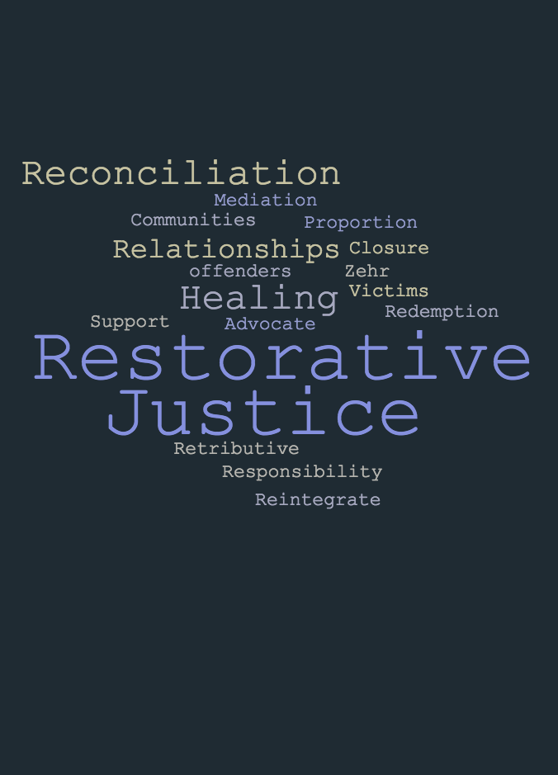
An Introduction to Restorative Practices with PBIS:
Day 1
Lori Lynass Ed.D.
Bridget Walker, Ph.D.
www.soundsupportsk12.com

Slide 2
OBJECTIVES
Understand core principals of restorative practices and how they differ from traditional punitive approaches.
Understand PBIS and restorative practices alignment.
Be able to lead circle dialogues.
Learn the restorative questions and how to use them.
Understand affective language statements.

Slide 3

THE CIRCLE: Opening Circle
Notes:
1. Name and role
2. What’s one school change that you’re finding success with.
3. Creating an effective Learning environment card
4. Practice Active Listening: Use a challenge that you’re facing.
5. Debrief why the circle was an effective way to get to know each other.

Slide 4

THE CIRCLE: Background
People are worthy and relational
Nurture Healthy Relationships
Create just and equitable learning environments
Repair harm and transform conflict
Respect
Dignity
The Little Book of Restorative Justice in Education
Katherine Evans and Dorothy Vaandering
Mutual Concern

Slide 5
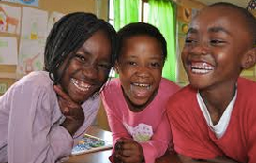
RESTORATIVE JUSTICE: Building a Positive School Climate

Slide 6
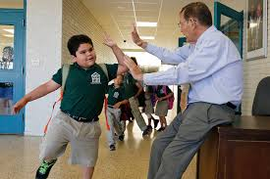


‘‘No significant learning occurs without a significant relationship.’’ - Dr. James Comer

Slide 7
SCHOOL SAFETY: Two Camps
ZERO TOLERANCE Policies
“One strike and you’re out” regardless of the situation or past history
Meant for illegal behaviors but then expanded to disrespect and disobedience
Emphasize the importance of listening
Encourage exclusionary practices for minor behaviors to prevent escalation
Adopt a strong but caring stance against a code of silence
Involve all community members
Develop trusting relationships
U.S. Department of Education and U.S. Secret Service, 2005
Bullying prevention and intervention
Prevention &
Threat Assessment
Notes:
Zero Tolerance:
One strike and you’re out” regardless of the situation or past history
Meant for illegal behaviors but then was expanded to disrespect and disobedience
Encourage exclusionary practices for minor behaviors to prevent escalation.
Emphasize the importance of listening in schools
Adopt a strong but caring stance against a code of silence
Bullying prevention and intervention
Involve all school community members in creating and sustaining safety and respect
Develop trusting relationships between each student and at least one adult
U.S. Dept. of Ed & U.S. Secret Service, 2005

Slide 8
RESTORATIVE PRACTICES
Restorative practice is a social science that studies how to build social capital and achieve social discipline through participatory learning and decision making.
  IIRP, 2014

Slide 9
RESTORATIVE PRACTICES: The “Why”
School suspensions account for roughly one-fifth of the white-black achievement gap.
  Perry and Morris 2015
Punishment often increases behavior and only gains us temporary compliance.
  Kohn, 2011.
Creates shared power and helps students learn to resolve conflicts.
Creates a more positive school climate and sense of ownership.

Slide 10
RESTORATIVE PRACTICES: School as a Protective Factor and as a Resilient Context
Connection
Academic Success
Supported Transitions
Positive Relationships With Adults And Peers
Caring Interactions
Social Emotional Learning
Positive Interactions With Pro-social (Not, Anti-social) Peers
Stability
Positive Approaches To Disciplinary Infractions & Services And Supports
Osher, D.
Notes:
Oprah story about 4th grade teacher. Eric Jensen, You have to build relationships if you want students who experience poverty to learn.

Slide 11

What We Hope To See From Students
Sound Decision Making Skills
Regulation of Emotions and Body
Personal Insight
Flexibility and Adaptability
Empathy
Morality
Daniel Siegel, No Drama Discipline 2016
Icon By Gan Khoon Lay

Slide 12
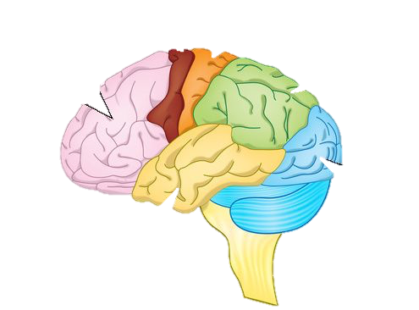
Motor Cortex
Movement
Frontal Lobe
Executive functions, thinking, planning, organizing and problem solving, emotions and behavioral control personality
Sensory Cortex
Sensations
Parietal Lobe
Perception, making sense of the world, arithmetic, spelling
Occipital Lobe
Vision
Temporal Lobe
Memory, understanding, language
Notes:
Hand brain model: flipping your lid

Slide 13
RESTORATIVE PRACTICES: Punishment vs Discipline
Punishment or consequence:
Immediate way to try and get a behavior to stop
“Make the child pay”
Discipline
Teaching, learning and giving instruction.
Offers skills that can change behavior.
It can help the developing brain make connections about good choices.

Slide 14

RESTORATIVE PRACTICES:Punishment vs Discipline
We want to exclude the behavior not the person.
“You are important to us, but this behavior is not acceptable at school.”
By Yeoul Kwon

Slide 15
PBIS
Intensive Supports for Few
Predictable and Consistent Systems & Supports for ALL
Additional Supports for Some
Notes:
System of supports

Slide 16
RESTORATIVE JUSTICE
Repair Harm and Relationships
Make and Develop Positive Relationships
Maintain Relationships

Slide 17
RESTORATIVE JUSTICE
Harm
Formal
Prevention
Intervention
Informal
Dispute
Notes:
All of RJ on a continuum of these three things—PBIS prevention to intervention, harm to dispute—small to large, informal to formal—community circles to when harm has been done. 80% should be in the prevention area

Slide 18
Video: Restorative Justice in Spokane
https://www.youtube.com/watch?v=nUIRkuOFtw0

Slide 19
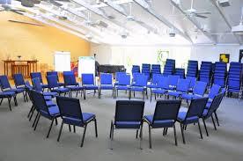
RESTORATIVE JUSTICE: Fishbowl Circle

Slide 20

RESTORATIVE JUSTICE: School Environment/ Culture Circle Rounds
What is the difference between School Culture and School Climate?
How do you measure
them?
What do you do
with the data?
Notes:
Trade circles after a question or two.
‘”To change culture, we must make decisions and actions that foster our collective culture. Culture takes purpose to change; climate can change in moments. Alternatively, your classroom climate influences student behaviors, and the collective behaviors demonstrate classroom culture. You influence the climate to develop the culture you want. Group expectations, rules, and behaviors compose culture.” Eric Jensen

Slide 21
RESORATIVE JUSTICE: Fishbowl Circle Debrief
Notes:
Did everyone feel they had a voice? Where you engaged in the process?

Slide 22

FAIR PROCESS
Individuals are most likely to trust and cooperate freely with systems- whether they themselves win or lose by those systems- when fair process is observed.
Fair Process: Managing in the Knowledge Economy: Chan Kim and Renee Maugorgne, Harvard Business Review January 2003.
Notes:
Fair Process started in the business world

Slide 23
FAIR PROCESS
Produces voluntary
co-operation
WHICH
Drives performance
Leads individuals to go beyond the call of duty by sharing their knowledge and applying creativity.
WHICH
Fair Process: Managing in the Knowledge Economy: Chan Kim and Renee Maugorgne, Harvard Business Review January 2003.
Notes:
We get some great outcomes when we regularly use fair process

Slide 24



FAIR PROCESS: CORE COMPONENTS
Engagement
Explanation
Expectation Clarity
By HeadsOfBirds, JP
By Adrien Coquet, FR
By icon 54
Notes:
3 main components, for true fair process to take place, all three are needed

Slide 25
FAIR PROCESS: CORE COMPONENTS
Engagement
Involving individuals in decisions that affect them by asking for their input and allowing them to refute the merit of one another’s ideas.
Notes:
3 main components, for true fair process to take place, all three are needed

Slide 26
FAIR PROCESS: CORE COMPONENTS
Explanation
Everyone involved and affected should understand why final decisions are made as they are. Creates powerful feedback loop that enhances learning.
Notes:
3 main components, for true fair process to take place, all three are needed

Slide 27
FAIR PROCESS: CORE COMPONENTS
Expectation Clarity
Once decisions are made, new rules are clearly stated, so that everyone understands the new boundaries and consequences of failure.
Notes:
3 main components, for true fair process to take place, all three are needed

Slide 28
FAIR PROCESS
Fair Process is about interacting WITH others and allowing them to the space to be heard and treated with dignity and respect.
It provides opportunities for those affected by decisions to be included in the decision making process.
This contributes to an inclusive culture where all voices are valued and accounted for, ultimately leading to greater cooperation and follow-through of the decisions that are made.
Wachtel & Costello (2009), The Restorative Practices Handbook

Slide 29
Why Discipline Should Be Aligned With A School’s Learning Philosophy
Create a group of 4-5 participants. Choose a timekeeper.
2. Read the article and identify what you consider to be the most significant idea addressed in the article, and highlight that passage.
3. Follow the protocol for how to process the article.
Notes:
After they have finished processing the article, have a quick share out.

Slide 30


Slide 31

RESTORATIVE PRACTICES: To Punish or Not to Punish
To
For
Punitive
Permissive
The Restorative Practices Handbook by Bob Costello, Joshua Wachtel and Ted Watchtel
Notes:
What does a teacher who is punitive sound like?
What does a teacher who is permissive sound like?

Slide 32
RESTORATIVE PRACTICES: To Punish or Not to Punish
To
For
Punitive
Permissive
Control
Support
The Restorative Practices Handbook by Bob Costello, Joshua Wachtel and Ted Watchtel
Notes:
What does a teacher who is punitive sound like?
What does a teacher who is permissive sound like?

Slide 33
RESTORATIVE PRACTICES: Social Discipline Window
High
To | With
Not | For
Control
(limit setting, discipline)
The Restorative Practices Handbook by Bob Costello, Joshua Wachtel and Ted Watchtel
Support
Encouragement, nurture
Low
High
Punitive
Permissive
Notes:
With= exercise control, refusing to accept inappropriate behavior, but to do so in a caring and supportive way.
Engage them in finding a way to curb their own negative behavior
Hold accountable in an active way. Get a sense of closure ( victim and offender)
Restoring the relationship with those who have been harmed- restoring a sense of well being.

Slide 34
RESTORATIVE PRACTICES: Social Discipline Window
High
To Punitive power over | With Restorative power with
Not Neglectful power over | For Permissive power over
Control
(limit setting, discipline)
The Restorative Practices Handbook by Bob Costello, Joshua Wachtel and Ted Watchtel
Support
Encouragement, nurture
Low
High
Punitive
Permissive
Notes:
With= exercise control, refusing to accept inappropriate behavior, but to do so in a caring and supportive way.
Engage them in finding a way to curb their own negative behavior
Hold accountable in an active way. Get a sense of closure ( victim and offender)
Restoring the relationship with those who have been harmed- restoring a sense of well being.

Slide 35
SOCIAL DICIPLINE WINDOW: To
TO
Teacher Classroom Style
--------------------------------------------------------------------------------------------------------

Slide 36
TEACHING STYLE: Punitive (To)
Low Support/ High Control
Observe in the classroom:
Punitive and often uses loud, angry voice
Notices inappropriate behavior more than appropriate
Power struggles
Frequently gets immediate compliance
Notes:
Do this on charts around the room. Rotate groups to add to charts.

Slide 37
TEACHING STYLE: Permissive (For)
High Support/Low Control
Observe in the classroom:
Warm and supportive
Doesn’t set limits
Focus on effort and deemphasize quality
Inconsistent
Inappropriate behavior handled through ignoring or handles with weak reprimands or pleading.

Slide 38
TEACHING STYLE: Neglectful (Not)
Low Control/Low Support
Observe in the Classroom
Teacher remains at desk and students do not feel cared for
Teacher does not appear concerned about the quality of student work
May result from teacher stress, burn-out, depression or physical illness

Slide 39
TEACHING STYLE: Restorative (With) High Support/ High Control
Observe in the Classroom
Positive kind and supportive relationships
Effective discipline plan and orderly classroom
Sense of hope and optimism
Students feel sense of safety and competence
High level of work quality
High job satisfaction

Slide 40
TO
Teacher Classroom Style
------------------------------------------------------------------------------------------------------------
Likely Outcomes

Slide 41
LIKELY OUTCOMES: Punitive (To) Teaching Style
Low Support/High Control
Ordered classroom
Anxious, resentful students
Short term compliance but rarely lasting behavioral change
High Teacher Stress
Negative classroom atmosphere.
Notes:
Do this on charts around the room. Rotate groups to add to charts.

Slide 42
LIKELY OUTCOMES: Permissive (For) Teaching Style High Support/Low Control
Students feel liked and supported
Chaotic out of control classroom
Students do not feel secure in the teacher’s capacity to “manage”
Poor work quality
Students feel anxious and uncertain
High teacher stress

Slide 43
LIKELY OUTCOME: Neglectful(Not) Teaching Style Low Control/Low Support
May miss warning signs of academic or behavioral difficulties in students
Students may withdraw and feel worthless
Increased acting out in order to get teacher’s attention or because no sense of order or control in classroom
Limited meaningful learning taking place.
High teacher stress.

Slide 44
LIKELY OUTCOMES: Restorative (With) Teaching Style High Support/ High Control
Positive classroom atmosphere
Responsive /Flexible
High quality work output
Positive relationships

Slide 45
RESTORATIVE PRACTICES: Social Discipline Window
To Power Struggles Confrontation Authoritarian Win/Lose Retribution Stigmatize | With Consistent Accountable Responsive /Flexible Responsible Cooperation Negotiation
Not Uncaring Tired Lazy Burned Out Given Up | For Chaotic Inconsistent Excusing Giving In Blurred Boundaries Rescuing
High
Control
(limit setting, discipline)
The Restorative Practices Handbook by Bob Costello, Joshua Wachtel and Ted Watchtel
Support
Encouragement, nurture
Low
High
Punitive
Permissive
Notes:
With= exercise control, refusing to accept inappropriate behavior, but to do so in a caring and supportive way.
Engage them in finding a way to curb their own negative behavior
Hold accountable in an active way. Get a sense of closure ( victim and offender)
Restoring the relationship with those who have been harmed- restoring a sense of well being.

Slide 46
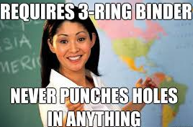


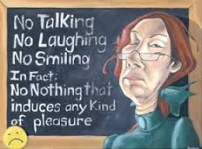
  What box do you naturally fall into?
  What triggers put you into the other boxes?

Slide 47
VIDEO: Community Circles in Action
https://www.youtube.com/watch?v=oc23H6RxWRo

Slide 48
RESTORATIVE PRACTICES: Continuum
Small impromptu conference
Group or Circle
Affective Statements
Affective Questions
Formal Conference
1
2
3
4
5
INFORMAL
FORMAL
The Restorative Practices Handbook by Bob Costello, Joshua Wachtel and Ted Watchtel

Slide 49

RESTORATIVE PRACTICES: Circles
Intentionally creating a space that lifts barriers between people, circles open the possibility for connection, collaboration, problem solving and mutual understanding.
Notes:
Frame Met West video

Slide 50
RESTORATIVE PRACTICES: Proactive Circles Uses
Relationship building
Establishing and reinforcing values and behavior expectations
Goal setting
Celebrations, recognition, achievements
Dialogue around topics of interest
Relevant content instruction
Class progress (behavior and academics)
Notes:
Frame Met West video

Slide 51

RESTORATIVE PRACTICES: Circle Process
Welcome/Mindful Moment
Review of Agreements
Introduce The Talking Piece
Opening Round(s)
Content/Focus Round(s)
Closing Round
Children Welfare Group by Gan Khoon Lay from the Noun Project

Slide 52

CIRCLE STARTERS: Groups of 5-6

Slide 53
CIRCLE STARTERS: Debrief

Slide 54
People are worthy and relational
Nurture Healthy Relationships
Create just and equitable learning environments
Repair harm and transform conflict
Respect
Dignity
The Little Book of Restorative Justice in Education
Katherine Evans and Dorothy Vaandering
Mutual Concern

Slide 55
Harm
Formal
Prevention
Intervention
Informal
Dispute

Slide 56
Closing Circle
Notes:
First Round: What are you feeling now?
Second Round: Hopes for tomorrow

Slide 57
See You Tomorrow!
Carol Frodge – cnfrodge@gmail.com
Lori Lynass- lynassl@gmail.com
Bridget Walker - bridgetwalkerphd@gmail.com
Sara Frodge- sara.frodge@gmail.com
www.soundsupportsk12.com

